Slide 1

Penetration Testing Methodology

Slide 2
WARNING You will be learning potentially dangerous techniques in this course. By continuing the beyond this point you agree that all the knowledge gained will be used in an ethical and safe manner. The point of this course is to learn about computer and network security, not to harm people or systems. If you do cause harm, either accidental or intentional, you will be responsible for your actions.

Slide 3
Penetration Testers
Mindset and Motivation

Slide 4
An Ethical Hacker Is…
As an ethical hacker there are two opposite ways of solving problems:
Follow a defined strategy, be thorough, methodical, recording all data, maintaining organization, and improving your process to maximize efficiency
Experimenting, thinking outside the box, being pragmatic, flexible, break habits and don’t think like a traditional IT administrator or developer
You will need to utilize both simultaneously to be a successful penetration tester
Learning to think like an attacker so we can help protect our systems from the threats to our security!

Slide 5
Motivation
Penetration testing is intended to:
Help a system owner get vulnerabilities patched before bad guys exploit them
Manage and reduce risk to a customer, system, or organization
Help make the case for a higher security budget!
Do this all by finding vulnerabilities, validating them through exploitation, and demonstrating the impact
Presenting discoveries in a report
A penetration test ends with a report to the system owner
Report details the risk of all findings and may provide mitigation recommendations
Risk may be explained in business or mission impact, accounting for the value of the assets
May be protecting financial data to physical safety and lives

Slide 6
Case Study
Phineas Fisher vs Hacking Team

Slide 7
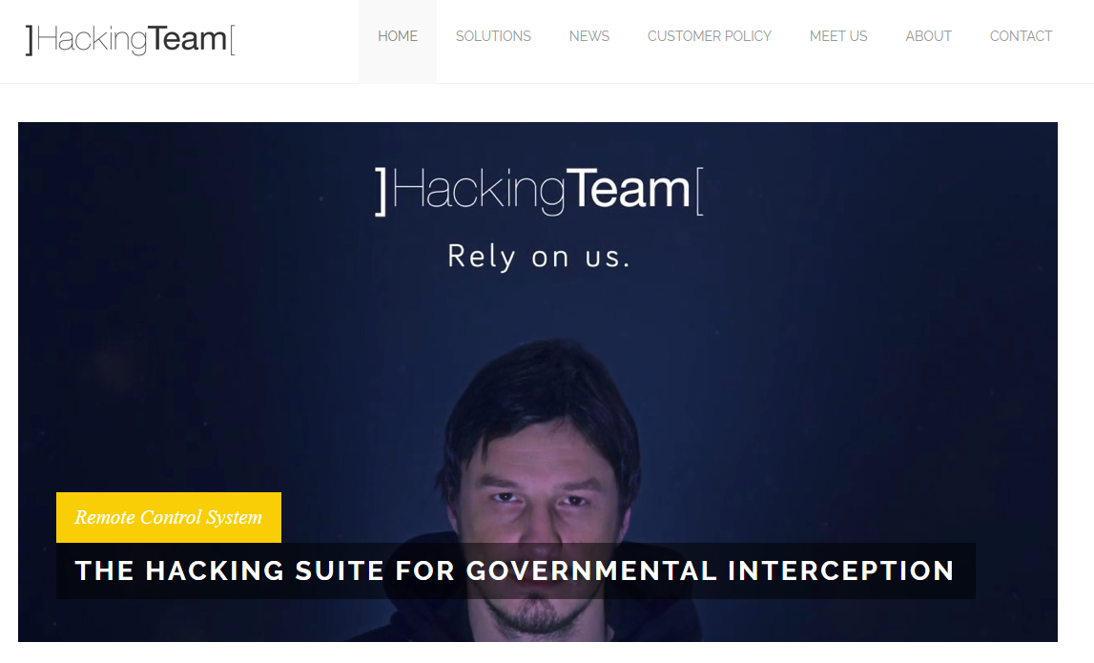
Case Study
In 2015, HackingTeam, an Italian cybersec company

Slide 8

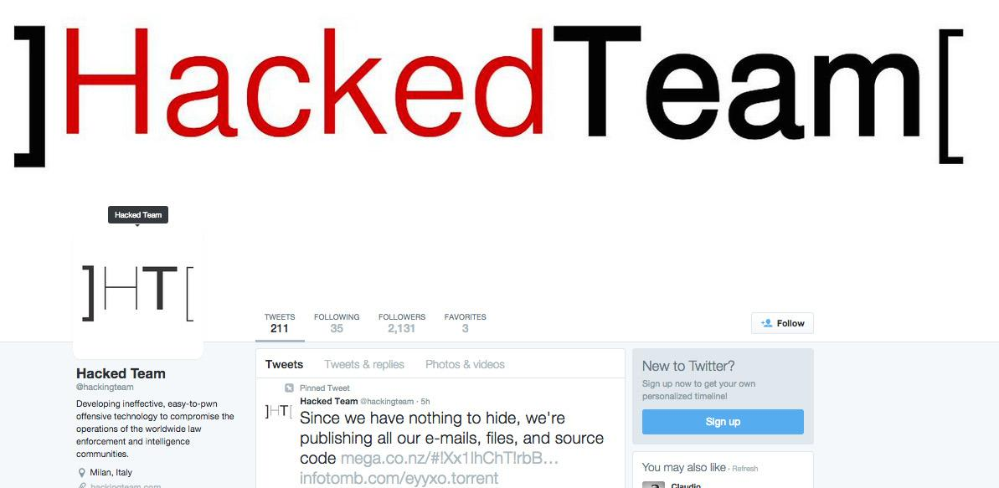
Case Study
In 2015, HackingTeam, an Italian cybersec company, was hacked

Slide 9
Case Study
A hacker known as Phineas Fisher (PF) attacked HackingTeam (HT)
Impact:
HackingTeam lost 400GB of sensitive data
Customer data, company email, company proprietary tools and source code
https://motherboard.vice.com/en_us/article/wnj9y5/hacking-teams-tools-arent-that-impressive-experts-say
Public image suffered greatly, lost credibility as competent cybersecurity experts
Methodology:
PF looked for internet-facing IPs, hosts, and services. Found few
Wrote a zero-day exploit for an embedded device / network appliance
Wrote a post-exploitation backdoor for the embedded device to gain persistence on the network
Tested the exploit and the post-exploit tools against other devices and companies first
Launched the exploit, gained a foothold, scanned and listened slowly
Found an iSCSI backup device on the same network, cleverly mounted it and browsed files and emails
In the backups, found a domain admin password, used it to weaponize more powerful hacking tools
Started downloading entire company email, file shares
Installed a keylogger and backdoored a users computer, then waited for the user to mount a TrueCrypt volume to steal very sensitive company data
Reset passwords, stole their twitter account
Later, the hacker posted a long manifesto talking about motivations, calling for action, but also explained how it was done
The zero-day was not discussed in detail

Slide 10
More Information
Journalism, quality summaries:
https://motherboard.vice.com/en_us/article/3dad3n/the-vigilante-who-hacked-hacking-team-explains-how-he-did-it
https://arstechnica.com/information-technology/2016/04/how-hacking-team-got-hacked-phineas-phisher/
Raw text of the manifesto:
https://www.exploit-db.com/papers/41915
Warning, this contains details on the hacker's motivations as an "anarchist revolutionary", take it with a grain of salt
Also contains lots of interesting details such as hacking methodology, tools, and provides detailed strategies

Slide 11
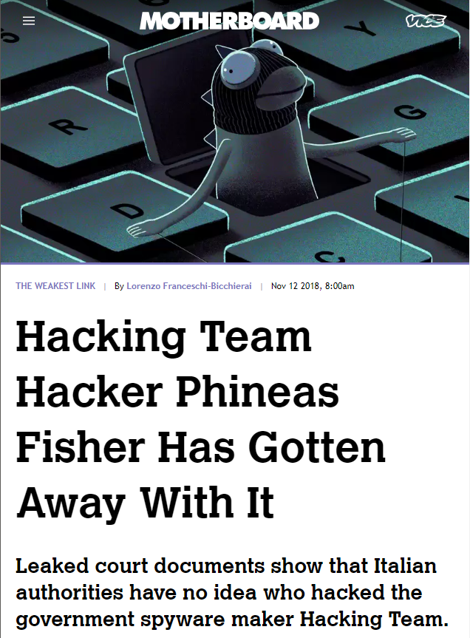
More Information
Conclusion - They got away with it! (November 2018)
https://motherboard.vice.com/en_us/article/3k9zzk/hacking-team-hacker-phineas-fisher-has-gotten-away-with-it

Slide 12
Case Study
Free Pizza

Slide 13
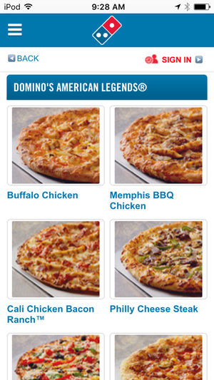
Case Study
Less serious case of Netsec failing
Security researcher darkp0rt found a vuln in the Dominos app
Motivation:
Sometimes Dominos gives the user a $10 coupon. Why?
Impact:
Free pizza, yum
Methodology:
Look at application source code
Use a web proxy (Burp) to monitor traffic
Notice that payment processing is done client side, on the app
MitM https request from app with a bogus CC#, but change
(payment == 'DECLINED') --into--> (payment == 'ACCEPTED')

Slide 14

More Information
Result
Dominos server thought the payment was successful
Dominos delivered the pizza
Full Writeup:
https://darkport.co.uk/blog/dominos-pizza-and-payments/

Slide 15
Vocabulary

Slide 16
Vocabulary
Vulnerability
A weakness in a business process, configuration, operating system, or application that can be used to create unintended and undesired scenarios
These can be considered opportunities for threat events (exploits)
Exploit
A threat event that weaponizes code or an application, to take advantage of a weakness for the purpose of having an intended effect to a target that would otherwise be impossible, unintended by the target owner, or unauthorized
Asset
Something that holds value, whether it’s a system or data, that a threat may be trying to access or compromise
Example: R&D data, Personnel data, credit cards, trade secrets,

Slide 17
Vocabulary
Threat
The thing that can cause our system harm, either adversarial, environmental, or accidental
Threat source
The actor (adversarial) or agent (environmental or accidental) that can trigger certain events which we try to protect against. Threats sources have certain properties such as posture, skill level, resources, intention, and motivation.
Adversarial threat postures:
Insider Threat - Threat posture which is internal to an organization (ex. Employees)
Nearsider Threat - Threat posture which is physically located with your system but has no system access (ex. visitors, maintenance, janitorial)
Outsider Threat - Threat posture which has no physical access. They may try to attack over the internet, wireless, or physical attacks.
Threat Event
The event that is doing some harm against a target. Adversarial could take the form of recon, creating weapons (exploits), attacking, exfiltrating data, or other malicious actions against a target. Non-adversarial examples might be disk failure, employee negligence, or natural disaster.

Slide 18
Vocabulary
Hacking
Using something in a deliberate way to create effects that is against the original intention or design
Ethical Hacking
Authorized behavior and actions to identify vulnerabilities of a system to help improve its security posture
Security Audit
Regulatory requirements for finance, corporate, government, or military systems
A thorough checklist of security controls are measured against both technical implementations, policies, and procedures

Slide 19
Vocabulary -
Penetration Testing vs Vulnerability Analysis
Almost identical terms
Targets an application, a system or server, or an entire network
Required a clearly defined scope - Permission and authorization to attack
Steps of ethical hacking, modeled after adversarial threats, performed against a system to discover vulnerabilities
Same Goal:
Help secure a targeted environment, system, network, or application, by recommending fixes and mitigations

Slide 20
Vocabulary -
Penetration Testing vs Vulnerability Analysis
Penetration Testing
Goes beyond identifying vulnerabilities
Validates findings through exploitation, and provide risk ratings for security findings according to assets and impacts
Vulnerability Analysis and Assessment
Like penetration testing but not as thorough, only part of the pen testing process
Same steps of Pen Testing, taken from Ethical Hacking, but stops at scanning
Typically doesn’t exploit vulnerabilities but still helps secure a target by providing mitigation recommendations

Slide 21
Vocabulary
White Box / Crystal Box Testing
Provided full access to networks and systems, configurations, admin/root access, source code
Usually results in more details and findings, but not as in-depth as Black Box Testing
Black Box Testing
Not provided any details on the target, system, network, application, or asset
May rely on open-source intelligence, social engineering
May target all exposures but will only go in-depth in certain vulns that can be exploited
Most accurate to mimicking outsider real-world attacks

Slide 22
Vocabulary
Blue Team
Team that is working almost entirely on the defensive side but may perform some tests to better secure system
e.g. Automated vulnerability scanning
Team works cooperatively with an organization to defend and protect their systems
Any kind of testing performed would be a White Box Test
Red Team / Teaming
Penetration testing team used to exercise the Blue Team and assess the security and response of an organization
Black Box Testing, acts as an outsider, mirroring real world Tactics, Techniques, and Procedures based off intelligence reports Still authorized but only known to a few people in an organization
May get details for white box testing for intentional planned exercises if the focus is to test the Blue Team in specific controlled situations
May also assess physical security and utilize social engineering
May not assess the entire system or network, only what is exposed to an outsider or nearsider
Provides an incomplete risk assessment of all systems but does a great job of mirroring real-world risk and prioritizing what mitigations and organizational improvements are needed

Slide 23
Comparison
Vulnerability Assessment
White Box
Depth
Black Box
Penetration Testing
Red Team
Breadth

Slide 24
Goal of Penetration Testing
The purpose of a Penetration Test is not for you to get root
This can be your personal goal, your heading, your target
When described in a report, do not write
The purpose of this penetration test was for me to get root...
As a system owner, I wouldn't hire you to just hack me and call it a day. I hire you to help me secure my system by hacking me.
Getting Root, Domain Admin, SYSTEM, etc. is just your objective
It steers your methodology and workflow
Your goal is to help secure the system
By describing and prioritizing flaws and how to fix them
Your findings and analysis become more actionable and meaningful by
demonstrating their impact and validation,
accomplished through exploitation

Slide 25
Methodology
Types of Penetration Tests
Testing Methodologies

Slide 26
Types of Tests
Most tests have:
Type - what does the test target
Category or posture - insider/Blue team/white box or outsider/Red Team/black box
Network tests
The most common and primary focus of this class
Scans the network, protocols, hosts, and services available for vulnerabilities and weaknesses
Typically a look at perimeter security (outsider threat) and/or internal network resources (nearsider and insider threat)
Client-Side tests
Testing the client software – apps, browser, configuration, OS
Web and web application
Testing the perimeter and functionality of internet-facing web resources
Notes:
Client-Side tests
As insiders have access to the internet, run applications, and have other capabilities, we test

Slide 27
Types of Tests, continued
Wireless testing
Assessing the use of wireless networks, encryption, authentication, DoS
Application Security Test
Testing software applications
Static Code Analysis Test
Having the source code available to identify code flaws, errors, looking for Common Weakness Enumeration (CWE - https://cwe.mitre.org/index.html)
Dynamic Analysis Test
Black box approach to application security testing
Debugging the binary, fuzzing memory, exposing sensitive data, looking for flaws and errors to exploit
Complete Red Team tests
Black box, outsider threat-style test
Different because this may include physical security, social engineering, stolen equipment, dumpster diving

Slide 28
Penetration Testing Methodologies
Testing methodologies cover the process of performing different types of pen tests
First - Understanding the attacker
Cyber Kill Chain
Model penetration testing frameworks
Penetration Testing Framework
Penetration Testing Execution Standard
Open Source Security Testing Methodology Manual
National Institute of Standards and Technology 800-115
OWASP Web App Testing Guide
These are not meant to be step-by-step or tool how-to guides
Theory which are then applies to many different situations

Slide 29
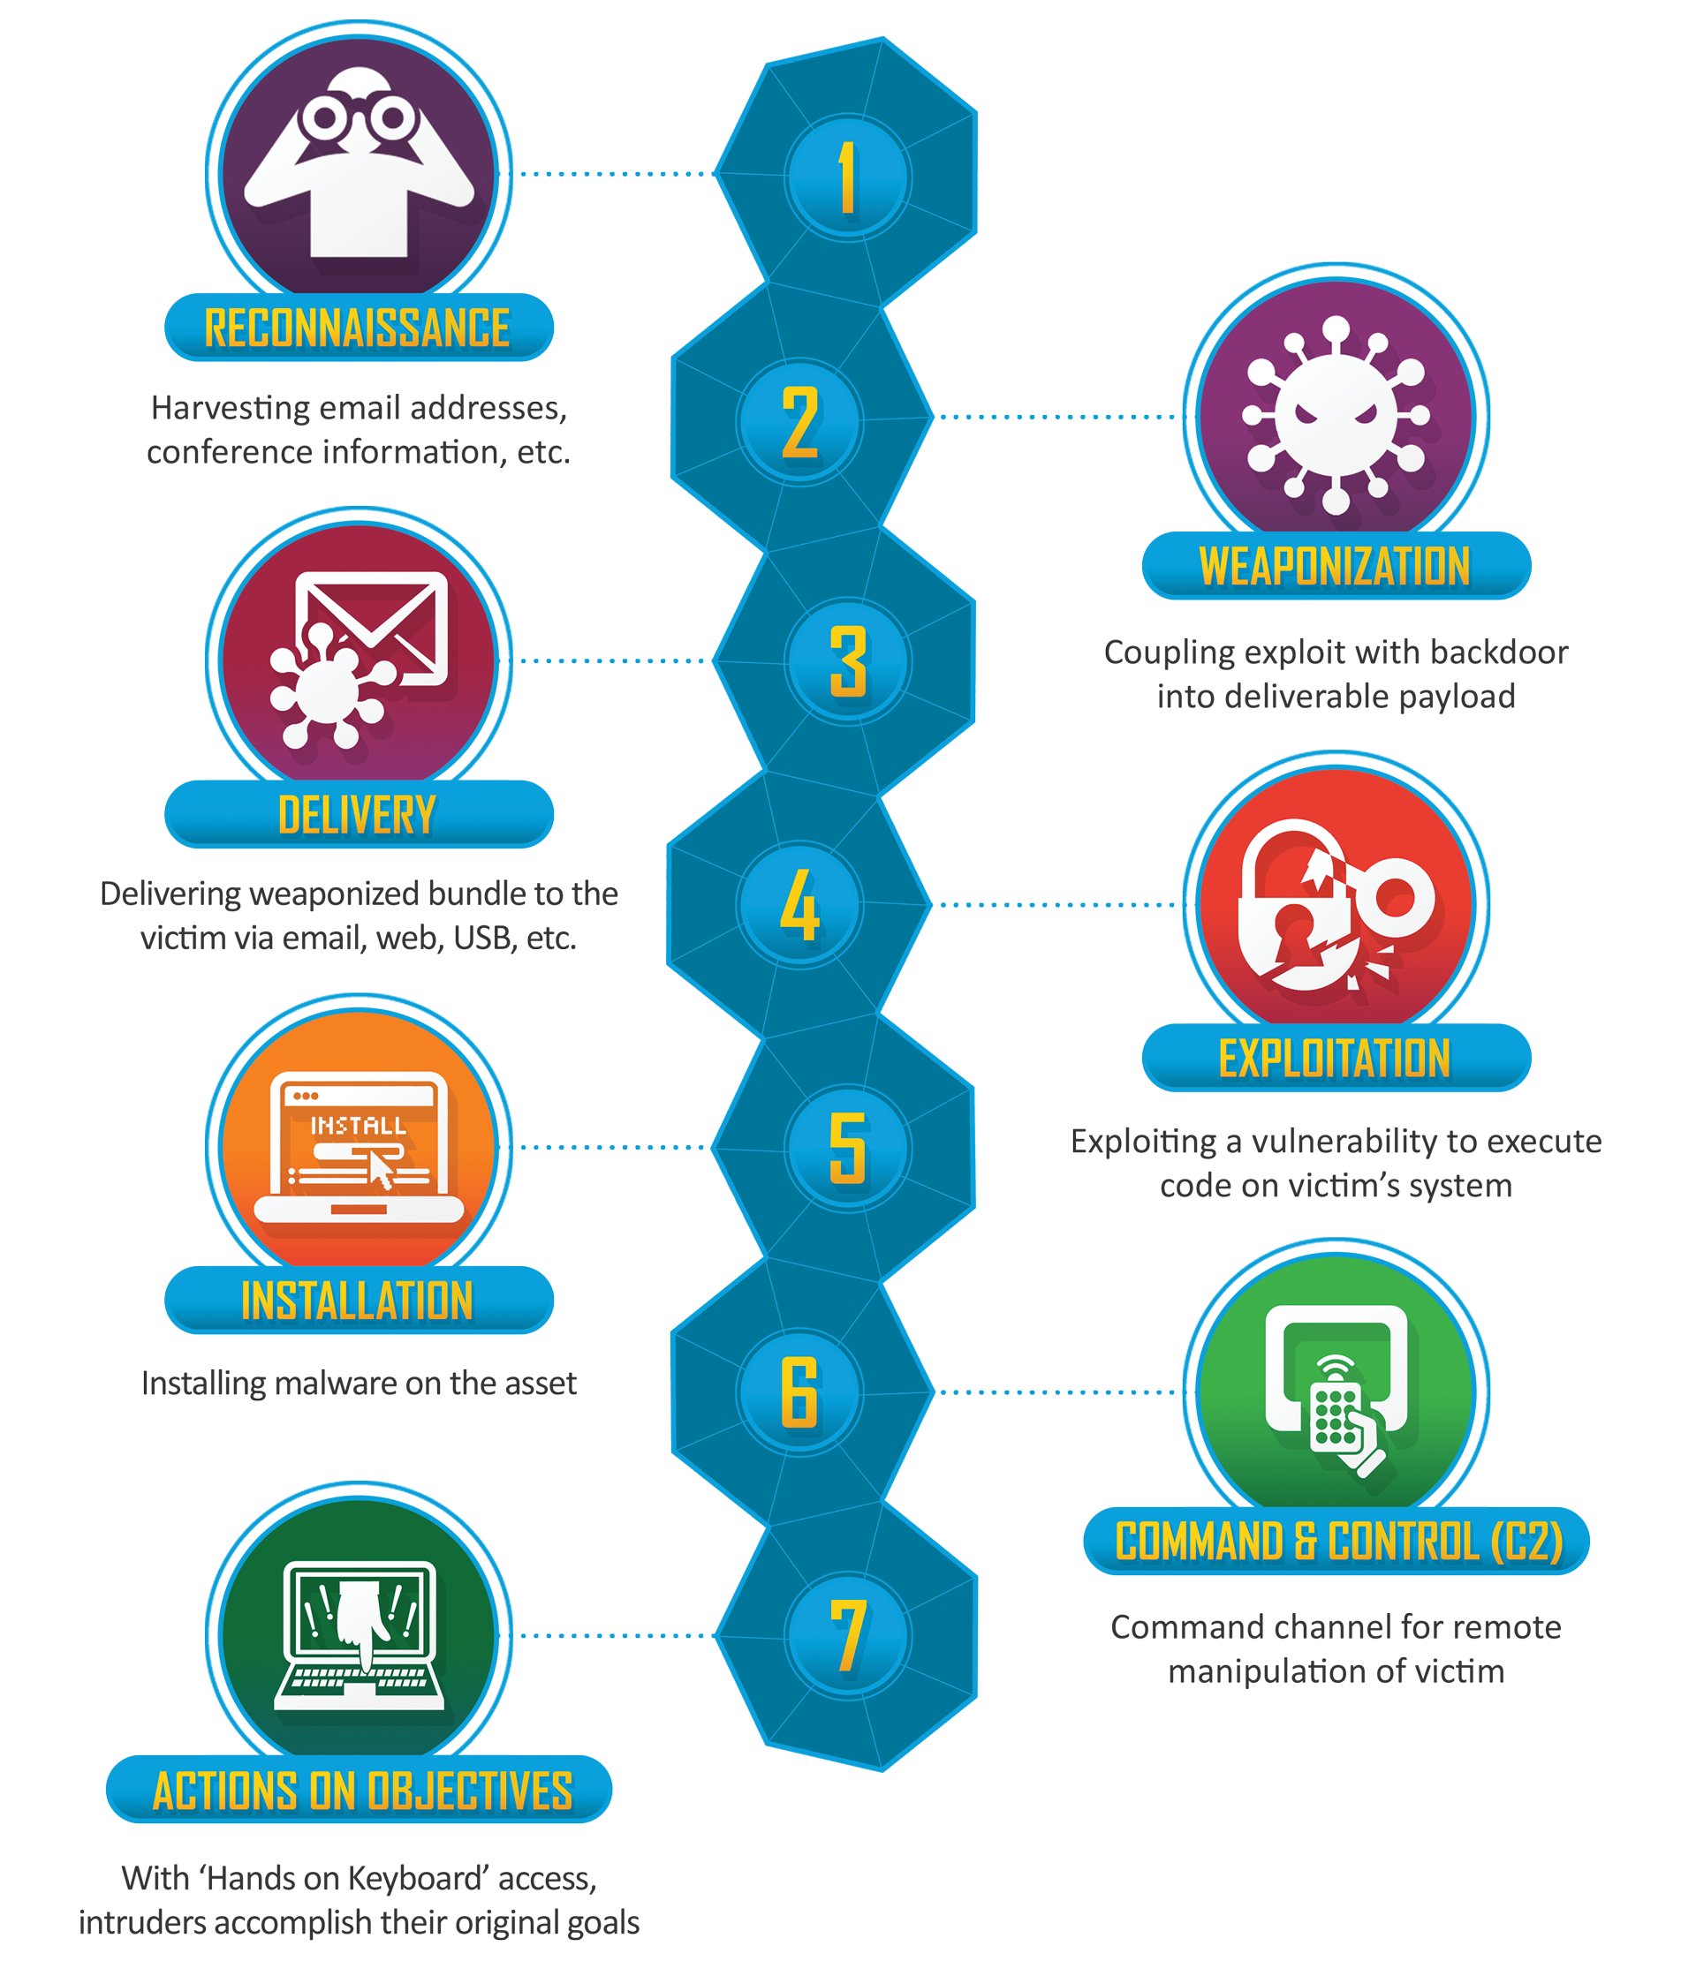
Cyber Kill Chain
https://www.lockheedmartin.com/en-us/capabilities/cyber/cyber-kill-chain.html
Developed by Lockheed Martin
The major steps to adversary compromise
Not exactly the methodology a pen tester wants to follow, but a useful guide
We'll see very similar steps

Slide 30
Penetration Testing Methodologies
Penetration testing is to help secure against real-world threats
By understanding the kill chain an adversary would use, the tester can think more like the attacker
Steps to compromise, such as a kill chain, allow testers to suggest mitigations that stop the kill chain at different steps
Consider this example:
A network has a predisposing condition. It must use a legacy operating system, Windows 2000, since this is the only OS that supports the legacy software applications that it must run.
By knowing that these OS vulnerabilities cannot be patched, we look to other steps in the kill chain to prevent adversary success
Limiting access and uptime, network boundary protection, traffic monitoring
Using the Kill-Chain to think about defense, vulnerabilities may remain, but there will be other mitigations in other steps

Slide 31
Penetration Testing Framework
http://www.vulnerabilityassessment.co.uk/Penetration%20Test.html
Provides very comprehensive hands-on penetration testing guide
Also Includes tools usage and syntax for each category
Network Footprinting (Reconnaissance)
Discovery & Probing
Enumeration
Password cracking
Vulnerability Assessment
Network Backbone
Server Specific Tests
Wireless Penetration
Physical Security
Final Report – template
Also includes very specific pen testing of AS/400, Bluetooth, Cisco, Citrix, VoIP

Slide 32
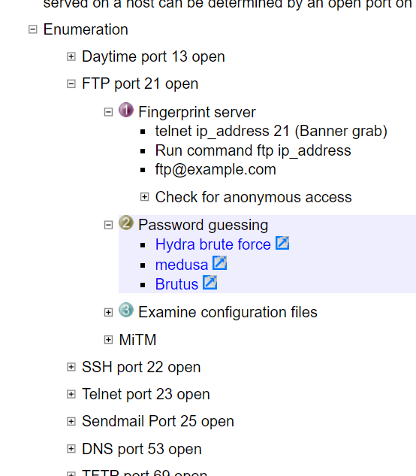
Penetration Testing Framework
Helpful for the technical portion and a good reference if you ever get stuck

Slide 33
Penetration Testing Execution Standard
(PTES)
http://www.pentest-standard.org/index.php/Main_Page
Free, open-source, wiki-style pen testing guide
PTES defines penetration testing as 7 phases.
Pre-engagement Interactions
Intelligence Gathering
Threat Modeling
Vulnerability Analysis
Exploitation
Post Exploitation
Reporting
Also provides hands-on technical guidelines for how to test, separate from the methodology but last update was April 2012
http://www.pentest-standard.org/index.php/PTES_Technical_Guidelines

Slide 34
Open Source Security Testing Methodology Manual (OSSTMM)
https://www.isecom.org/research.html
Created 2001 by ISECOM (Institute for Security and Open Methodologies)
Free but only have access to the latest finalized version
OSSTMM v3 2010
https://www.isecom.org/OSSTMM.3.pdf
Offers broad, abstract, and thorough auditing guidance of many categories without going into thick details or specific instructions
Operational Security
Trust Analysis
Human Security
Physical Security
Wireless Security
Communication Security

Slide 35
National Institute of Standards and Technology
(NIST) 800-115
http://ws680.nist.gov/publication/get_pdf.cfm?pub_id=152164
Technical Guide to Information Security Testing and Assessment
High level guide to security testing, covers more than ethical hacking
Does not go into tool and commands
Last update was 2008 but still relevant since it is not tool-oriented
Excellent for guiding and setting the mindset of security personnel

Slide 36
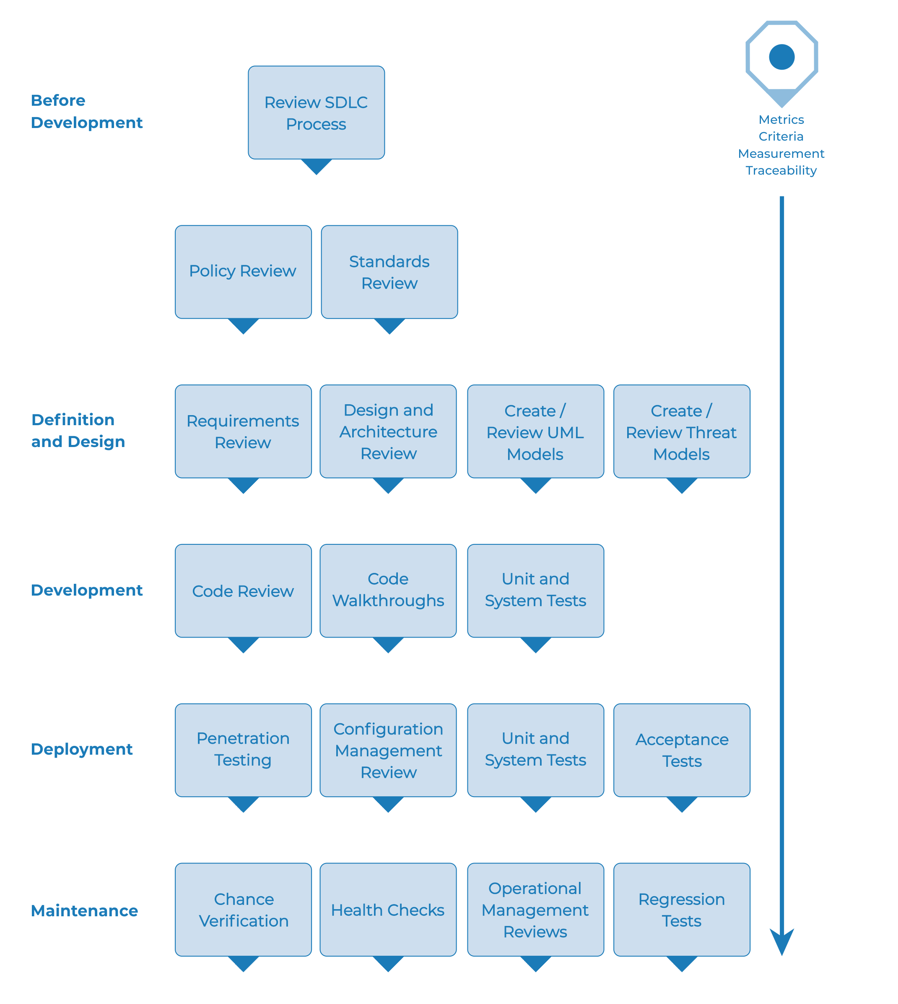
OWASP Web Testing Guide
Specific for Web Applications
Also gets into organizational security maturity
Testing before, during, and after development
Placing security into the SDLC
Provides specific steps and tests to implement during development
https://owasp.org/www-project-web-security-testing-guide/

Slide 37

OWASP Web Testing Guide
Web Application Testing Process
Broken up into 11-subcategory steps and 91 controls to test
Very thorough and an excellent guide
Passive Testing:
Information Gathering
Active Testing:
Configuration and Deployment Management Testing
Identity Management Testing
Authentication Testing
Authorization Testing
Session Management Testing
Input Validation Testing
Testing for Error Handling
Testing for Weak Cryptography
Business Logic Testing
Client Side Testing

Slide 38
Risk Scoring
Methodologies
Risk Definitions
CVSS
Examples

Slide 39
Risk Scoring Methodologies
A critical difference that a penetration test has over regular vulnerability scanning is the prioritization of findings
Testers need to be able to score and rank their findings
Only possible if testers understand the exploit, have threat data, and can determine the impact to the organization
Most methodologies include some form Risk Scoring
Next slides provide two examples of risk scoring
CVSS – Risk is based on a vulnerability
NIST - Risk is categorized by a specific threat event and impact

Slide 40


CVSS
Methodology to score vulnerabilities from 1-10
Open industry standard and now on Revision 3.1
Provides valuable technical impact of a vulnerability
but short of a risk score for the organization
Almost all published CVEs have a raw impact score based on CVSS
https://www.first.org/cvss/v3-1/cvss-v31-user-guide_r1.pdf

Slide 41
CVSS
Composed of three major parts
Base Score – First. A raw impact score for the vulnerability
Temporal Score – changes over time
Availability of exploits or patches
Environmental Score – Helps to understand the impact of the vulnerable system to the organization
Basic
Metric Group
Exploitability Metrics Impact Metrics
Temporal
Metric Group
Environmental
Metric Group
Attack Vector
Confidentiality Impact
Exploit Code Maturity
Confidentiality Requirement
Attack Complexity
Integrity Impact
Remediation Level
Integrity Requirement
Privileges Required
Availability Impact
Report Confidence
Availability Requirement
User Interaction
User Interaction
Modified Base Metrics

Slide 42
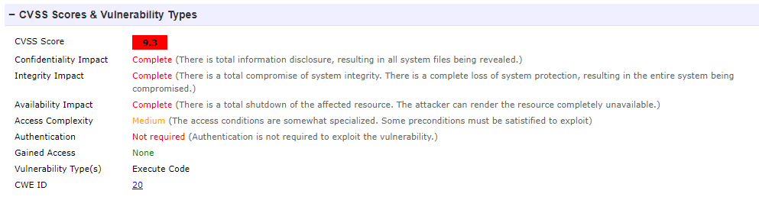
CVSS Example
Apache Struts Vulnerability – CVE-2018-17766
https://www.cvedetails.com/cve/CVE-2018-11776/
A CVSS score ranged from 1 to 10
Can be expressed as a string to understand the score specifics
Example: CVSS:3.1/AV:N/AC:M/PR:N/UI:N/S:U/C:H/I:H/A:H

Slide 43
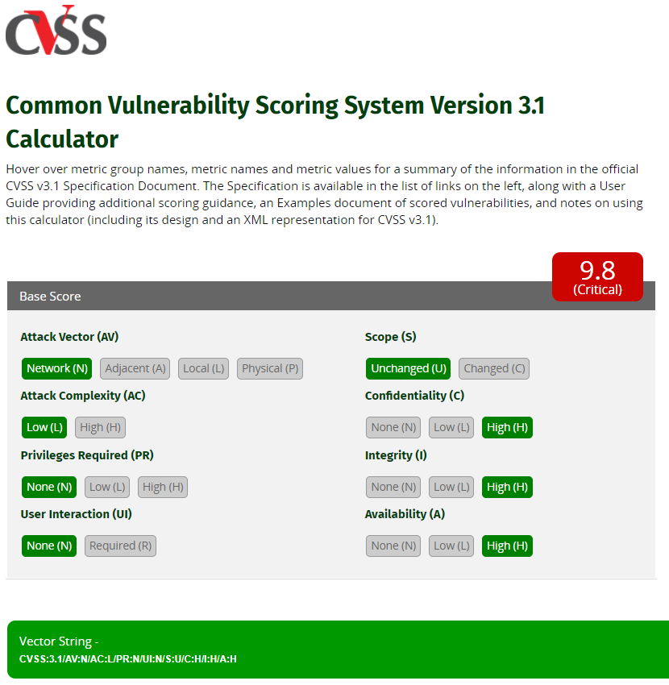
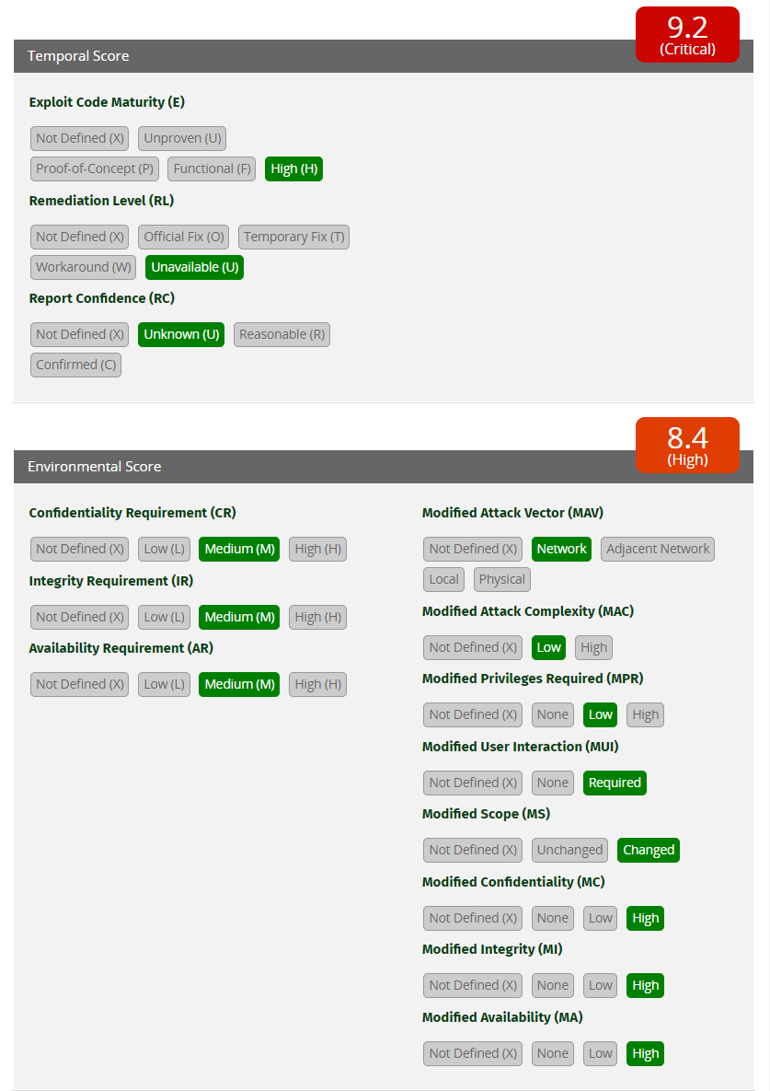
CVSS Calculator
https://www.first.org/cvss/calculator/3.1
Adding Temporal and Environmental data points can only reduce the score

Slide 44

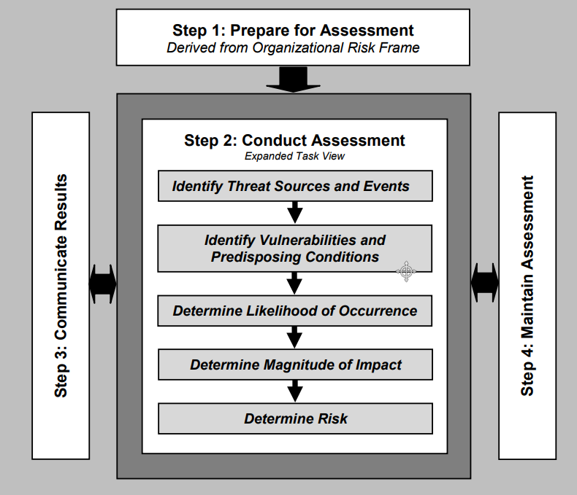
NIST
800-30: Guide for Conducting Risk Assessment

Slide 45
Risk Vocabulary
Likelihood of Threat Event Initiation or Occurrence
How likely it is that the threat event will be initiated by an adversary or occur if it's a non-adversary
Examples: once a year; somewhat likely; almost certain; daily
Likelihood of Threat Event Adverse Impact
How likely it is that the threat event will be successful in harming the system or organization
Example: Almost certain; unlikely to be successful;
Impact of Threat Event
Measurement of how harmful the threat event would be
Example: Negligible; Catastrophic; $100,000+
Risk
The overall measure of a vulnerability that can get exploited by a threat event which will have an impact to an asset
Can be quantitative or qualitative
Used to help provide recommendations in a test report.
Often expressed as negligible, low, moderate, high, critical
Risk = Impact + Likelihoods of (Initiation + Adverse Impact)

Slide 46
Likelihood and Risk
Overall Likelihood
Overall Risk
Very High
Very High
High
Moderate
High
Likelihood of Threat Event Initiation/Occurrence
Likelihood
Low High
Low High
Moderate
Low
Low
Very Low
Very Low
Low High
Low High
Likelihood of Adverse Impact (Successful Harm)
Impact
*Examples from NIST 800-30

Slide 47
Risk Examples
Target – A small local community e-commerce business, old version of Apache
Threat Event – Integrity Loss by Deleting or Disrupting a Web Server (DoS)
A threat actor tries to target specific flaws in a listening services to cause a DoS condition
A threat actor also deface the site, also resulting in a loss of integrity and availability
A threat actor may also gain access to sensitive or privileged information
Likelihood of Initiation (adversarial)
Logs show regular scans but not rarely seeing application errors
Unlikely to initiate an event (Low)
Likelihood of Adverse Impact
Running Apache from 2015, multiple known CVEs, including Apache Struts vulnerability
Highly likely to have adverse impacts (High)
Impact
DoS would mean downtime and loss of sales until service restarted and attack stopped
High or severe adverse effects (High)
Other integrity or confidentiality impacts may elevate impact to Very High
Risk – Moderate to High

Slide 48
Risk Examples
Target – A small local community e-commerce business
Threat Event – Power Failure
Loss of power to a server room, trigger system downtime and a DoS condition
Likelihood of Occurrence (non-adversarial)
Building has above ground cables surrounded by trees
During bad storms (5-10 year) power loss is almost guaranteed
Somewhat Likely (Moderate)
Likelihood of Adverse Impact
Battery and automatic generator backup, up to 48 hours
Power loss would have to be prolonged
Not likely to have adverse impacts (Low)
Impact
DoS would mean downtime and no sales
When the community is hit with severe storms, e-commerce sales drop significantly anyway
Limited impact to the business (Low)
Risk – Low

Slide 49
Which to use?
Like selecting a Penetration Testing methodology, it depends on your target and test type
Understand what would be the most useful for the organization
The penetration test part of a specific process?
Financial system audit and accreditation
Government authorization to operate
Commercial risk review
Technology security assessment
Different industries may be more familiar with a specific risk score
Use what is familiar for your customers
Be flexible
CVSS is a great start but isn’t enough – Need to assess risk for each instance of a vulnerability

Slide 50
Testing Toolkit
Kali
Protecting Data
Notes
Collaboration

Slide 51
Types of Toolkits
Considering the variety of ethical hacking domains, lots of requirements
Many tools are for either Windows or Linux, best to have both!
OS X is acceptable but you will end up virtualizing both Win and Linux anyway
Software
Windows 10
Linux distribution – Kali
https://www.kali.org/
Virtualization - Free (VirtualBox, XenServer) or Professional (VMWare)
Free / Open source tools
Nmap, tcpdump, Wireshark, OpenVAS, Metasploit, Burp Suite, notepad++
Licensed tools – We will not be using this class
Retina, Nessus, FTK, Metasploit Pro, HP Fortify, Burp Suite Pro, WebInspect, IDA Pro, CORE Impact, MS Office

Slide 52
Toolkits
Hardware
Machines for testing – not your daily use machine!
Expect anything on this machine to potentially be posted on Wikipedia and/or deleted forever
Virtual Machines can be used instead
External storage
Mobile phones for app testing
Compatible radios
802.11
Bluetooth
IoT
Switches, routers, networking equipment
Cloud resources
Kali over AWS (Free tier available)
https://aws.amazon.com/marketplace/pp/B01M26MMTT
EC2 for password cracking

Slide 53

What is Kali?
Kali Linux is a Debian-derived Linux distribution designed for penetration testing
Free, created by Offensive Security
The successor to Backtrack, Ubuntu-derived pen testing distro
Kali incorporates 300+ penetration testing and security auditing tools
It's not the holy grail but it's nice having most of the tools that we'll use the most all within a single distribution
In some cases, our physical toolkit will not be allowed on a target network but a virtual machine or image will be allowed. Kali is perfect for this situation since it already exists
Some sample programs which we will look at include
Kismet for wireless site surveys (wardriving)
Nmap for port and vulnerability scanning
Wireshark for monitoring network traffic
Aircrack-Ng for testing the security of wireless networks
Metasploit for network penetration testing
DDoS/DoS tools rarely are used legitimately so they are not included

Slide 54
Toolkit for this Semester
We will be using Kali Linux for our testing
More on setting up Kali will be included with the first lab
Live boot & installed deployments:
https://www.kali.org/downloads/
Kali Virtual Machine Images:
https://www.offensive-security.com/kali-linux-vmware-virtualbox-image-download/

Slide 55
Virtualization
Virtualizing makes a pen tester’s toolkit easy to manage, configure, backup, and duplicate
VirtualBox is a completely free virtualization tool able to make new VMs, import, and export appliances. Windows, Mac, and Linux
I use and recommend VirtualBox
https://www.VirtualBox.org/wiki/Downloads
VMware Workstation Player is free (not the pro version) and Kali VMWare images are available from their website. You cannot make new VMs with the free version
http://www.vmware.com/products/player/playerpro-evaluation.html
How you set up your pen testing toolkit is up to you
I use Windows 10 with VirtualBox and Kali
If needed, I also use a live version of Kali with persistent storage
VMware / Windows has some compatibility issues with USB radios and wifi cards
If virtualizing your toolkit, enable bridged network connection
This will allow the testing OS to talk directly to the network with minimal interference by the host OS and virtualizing software

Slide 56
Testing Network
Ideally, we want to be as close to our target as possible
Direct connection to LAN
No firewall or IDS/IPS unless explicitly part of the test
For internet-based scanning, we need to work with our ISP
ISPs detect and block scanning, recon, exploits, etc
ISPs may also block incoming request responses
Tests will be unsuccessful and full of errors
Contact your ISP, explain your role as a penetration tester
And be prepared to pay more for your monthly service
May also be required to fill out a waiver of liability for DoS or provide your rules of engagement/test plan

Slide 57
Firewalls and local network
For our testing machines, we can’t run AV, personal, or network firewall
AV will stop processes
Firewalls will block traffic
Proxies may modify http and other types of traffic
Unless this is intentional
Network devices performing NAT or PAT may fill up their tables, dropping traffic

Slide 58
Testing Toolkit - Hardening
Our testing machine will be exposed – No AV, firewall, IDS, etc
Need to make sure everything is patched and configured for security
Shut off all unnecessary services
Properly configure all OS security controls
What are my proper OS security configurations?
Center for Internet Security – Security Benchmarks
NYU has a complete membership to all tools – registration required
https://benchmarks.cisecurity.org/downloads/browse/index.cfm?category=benchmarks
DoD Security Technical Implementation Guides (STIGs)
http://iase.disa.mil/stigs/Pages/a-z.aspx
STIG Viewer - http://iase.disa.mil/stigs/Pages/stig-viewing-guidance.aspx

Slide 59
Encryption and External Storage
Ideally, we will not be storing any sensitive or critical information on our testing machine
Even with all the system hardening, our machine is still exposed
Expect it to be targeted, plan on it to get owned
Remember, test data may contain very sensitive customer information
USB / SD card storage for emerging test results
Full drive encryption
Window - BitLocker
Linux - Cryptographic File System
On-the-fly Encryption (OTFE)
VeraCrypt, open source (TrueCrypt successor), still actively maintained

Slide 60
Scrubbing your Toolset
After each test, your pen testing machines will contain logs and traces of customer data
Network information
Vulnerabilities
Successful exploits
Pillaged sensitive information
Always move data to another secure system for processing and analyzing
Very important to wipe all this case data from your machines as soon as it’s no longer needed

Slide 61
Scrubbing your Toolset
Secure deletion tools that use overwriting
Linux – Shred
Only deletes files not directories
You could shred one file at a time, or
find [PATH_TO_DIR] -exec shred -u {} \;
Windows – Cipher
Rewrites free space on entire partition
first delete all files and directories
C:\> cipher /w:C

Slide 62
Note Taking
When performing large tests and parsing though scan data, we need an easy way to organize, visualize, search, and parse data
Tools such as notepad++ are great for taking short notes only
We may have an inventory of thousands of machines
Free tools such as OneNote, Cherrytree, Joplin, or KeepNote
Offer hierarchies, multiple tabs and sections
Good for organizing subnets, hosts, targets
Sometimes offer advanced functions, search, cloud support (OneNote)
Be careful to not automatically upload sensitive information if unauthorized
Professional tools and free versions build for Pen Testers
Dradis Framework, designed for pen testers, has built-in parsing of common tool output such as nmap and nikto
Consider the size and scope of your test
Note taking tool and style is a personal preference

Slide 63
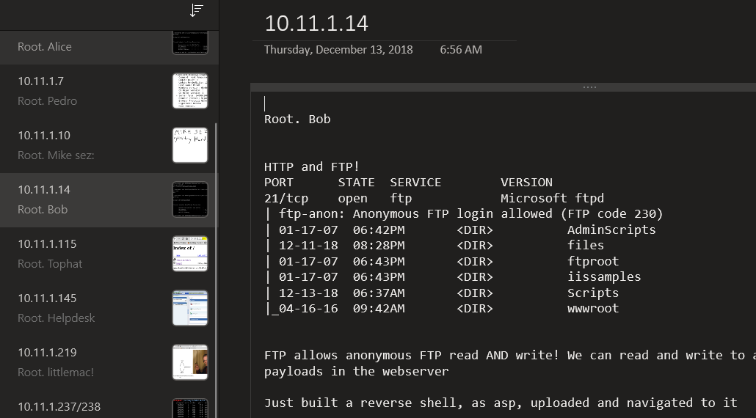
OneNote Example
Tabs and Pages can be built out for different targets

Slide 64
Professional Note Taking for Pen Testing Teams
There are also options for teams of people
Avoids issues such as configuration control for people contributing to the same host or writeup
Client-server model hosted for just the test
E.g. Jira, Dradis, Sharepoint
Ensures secure note taking and proper protection
Check-ins during a test ensure backups
Allows for testing machines to be wiped on-site, only physically secure and protect the note-taking server

Slide 65
Module Review

Slide 66
Summary
Pen Tester vs Unethical Hacker - Permission
Case Study example of two successful exploits
Vocabulary
Black box vs White Box
Red vs Blue Teams
Testing Frameworks and Methodologies
Risk Scoring
Risk = Likelihood * Impact
Important Point - Pen Testing methodologies
When you get stuck, take a step back and think through the process!
Reference these methodologies and resources
Technical walkthroughs are good resources but become outdated quickly

